Slide 1
Computer Architecture & Assembly Language
CSC-250
COURSE LECTURE
COMPUTER SCIENCE DEPARTMENT
SIBAU KANDHKOT CAMPUS

Slide 2
Computer Architecture
A very good example of computer architecture is von Neumann architecture, which is still used by most types of computers today.
This was proposed by the mathematician John von Neumann in 1945. It describes the design of an electronic computer with its CPU, which includes the arithmetic logic unit, control unit, registers, memory for data and instructions, an input/output interface and external storage functions
Involves Logics (instruction address data types memory optimization)
Show responsibility who does interconnect & connectivity structure
Functional requirements
High level design
Focus on understanding problem

Slide 3
Computer Architecture
A modern computer is an electronic, digital, general purpose computing machine that automatically follows a step-by-step list of instructions to solve a problem. This step-by step list of instructions that a computer follows is also called an algorithm or a computer program.
Why study computer organization and architecture?
  Design better programs, including system software such as compilers, operating systems, and device drivers.
  Optimize program behavior.
  Evaluate (benchmark) computer system performance.
  Understand time, space, and price tradeoffs.
Computer organization
  Encompasses all physical aspects of computer systems.
  E.g., circuit design, control signals, memory types.
  How does a computer work?

Slide 4
Computer Architecture
Visible attributes of system to programmer
System competitive techniques for addressing design
Structural behavior
Instruction Set Architecture (ISA): This is the embedded programming language of the central processing unit.
It defines the CPU's functions and capabilities based on what programming it can perform or process.
This includes the word size, processor register types, memory addressing modes, data formats and the instruction set that programmers use.
Microarchitecture: Otherwise known as computer organization, this type of architecture defines the data paths, data processing and storage elements, as well as how they should be implemented in the ISA.

Slide 5
Computer Architecture
Focuses on the structure (the way in which the components are interrelated) and behavior of the computer system and refers to the logical aspects of system implementation as seen by the programmer
Computer architecture includes many elements such as
  instruction sets and formats, operation codes, data types, the number and types of registers, addressing modes, main memory access methods, and various I/O mechanisms.
The architecture of a system directly affects the logical execution of programs.
The computer architecture for a given machine is the combination of its hardware components plus its instruction set architecture (ISA).
The ISA is the interface between all the software that runs on the machine and the hard
Studying computer architecture helps us to answer the question: How do I design a computer?

Slide 6
Computer Architecture Layer
The term layer with regard to computer architecture typically represents the way abstraction is used to describe computer systems.
A layer is the term used to describe the different levels at which you can place an object.
There are many different abstractions that have been used in computer architecture.
If you restricted yourself to four layers, they may be defined as:
1) algorithm,
2) programming language/compiler,
3) processor/memory,
4) I/O.

Slide 7
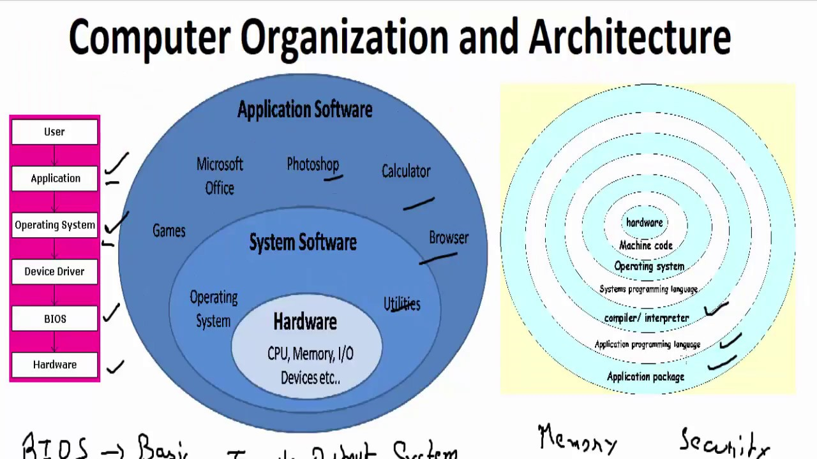

Slide 8
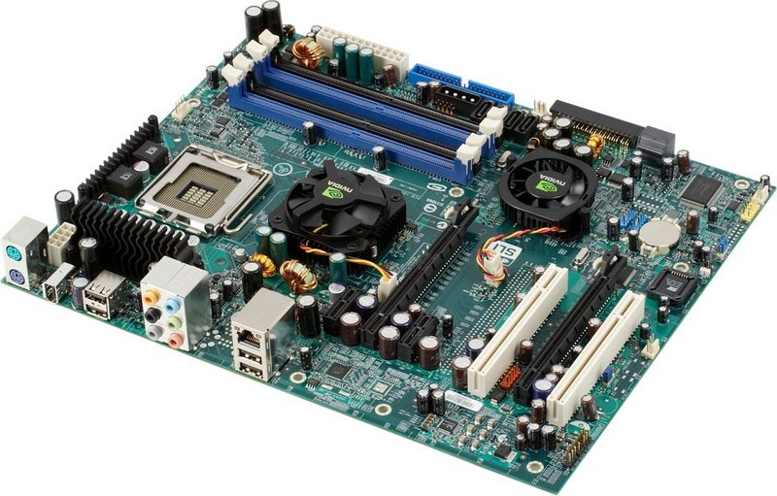

Slide 9
Design
This includes all hardware components in the system, including data processors aside from the CPU, such as the graphics processing unit and direct memory access.
It also includes memory controllers, data paths and miscellaneous things like multiprocessing and virtualization.
Develop system components
Understand configuration
Hardware design

Slide 10
Why We Study Computer Architecture
The study of computer architecture and organization focuses on the interface between hardware and software, and emphasizes the structure and behavior of the system.
As computer users, we probably do not have to worry about this anymore than we need to know what our cars look like under the hood in order to drive them.
We can certainly write high label language programs without understanding how these programs execute.
We can use various application packages without understanding how they really work. But what happens when the program we have written needs to be faster and more efficient or the application we are using does not do precisely what we want?
As Computer Scientists, we need a basic understanding of computer system itself in order to rectify these problems.

Slide 11
Computer Architecture & Organization
Architecture is those attributes visible to the programmer
  Instruction set, number of bits used for data representation, I/O mechanisms, addressing techniques.
  e.g. Is there a multiply instruction?
Organization is how features are implemented
  Control signals, interfaces, memory technology.
  Organization differs between different versions
  e.g. Is there a hardware multiply unit or is it done by repeated addition?

Slide 12
Structure
A hierarchical set of interrelated sub system
At each level system is consist of a set of components
The way in which the components are interrelated
Internal structure of a digital computer, encompassing the design and layout of its instruction set and storage registers.
Top to Bottom
Bottom to Top

Slide 13
Structure - Top Level
Peripherals
Computer
Central
Processing
Unit
Main
Memory
Computer
Systems
Interconnection
Input
Output
Communication
lines

Slide 14
Structure - The CPU
CPU
Computer
Arithmetic
and
Login Unit
I/O
Registers
System
Bus
CPU
Internal CPU
Interconnection
Memory
Control
Unit

Slide 15
Structure - The Control Unit
Control Unit
CPU
ALU
Sequencing
Login
Internal
Bus
Control
Unit
Control Unit
Registers and
Decoders
Registers
Control
Memory

Slide 16
Function
The operation of each individual component as part of the structure
All computer functions are:
  Data processing
  Data storage
  Data movement
  Control

Slide 17
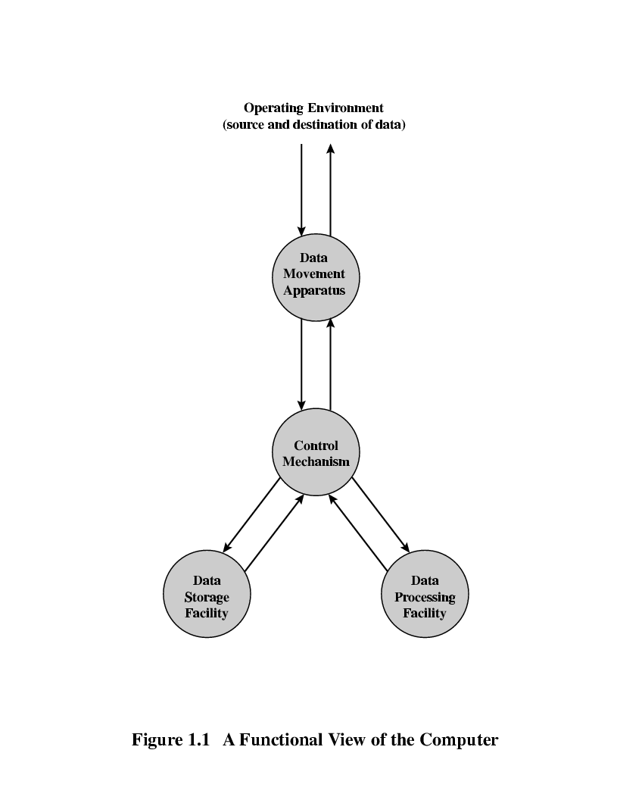
Functional View

Slide 18
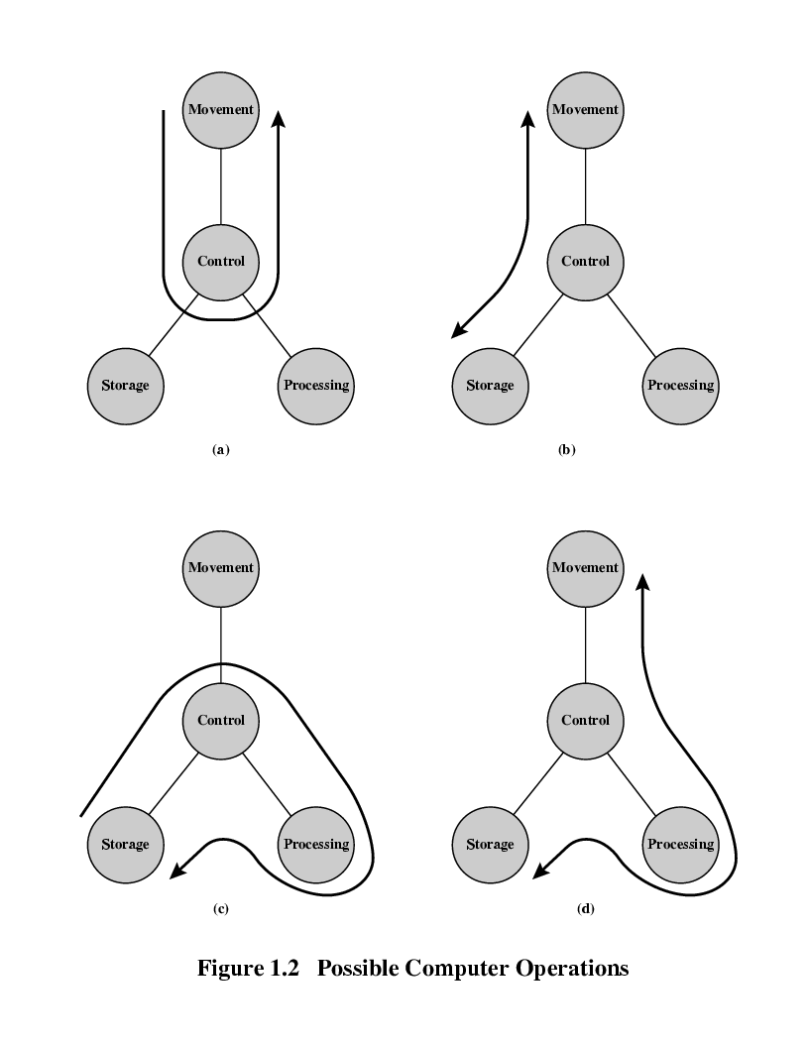
Operations (a) Data movement

Slide 19
Operations (b) Storage

Slide 20
Operation (c) Processing from/to storage

Slide 21
Operation (d) Processing from storage to I/O

